Slide 1
PROBABILITY

Slide 2
Probability
The presentation and interpretation of chance outcomes that occur in a planned study or scientific investigation.
For example, we may record the number of accidents that occur monthly at the intersection, the tossing of a coin, the no of items found to be defective or non-defective when items are inspected.

Slide 3
Sample Space
The set of all possible outcomes of a statistical experiment is called the sample space and is represented by the symbol S.
Examples:
The sample space S, of possible outcomes when a coin is flipped
S = {H, T}
The sample space S, the experiment of tossing a die. If we are interested in the number that shows on the top face
S = {1, 2, 3, 4, 5, 6}
The sample space S, the experiment of tossing a die. If we are interested only in whether the number is even or odd.
S = {even, odd}

Slide 4
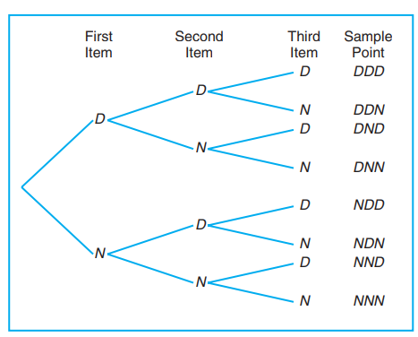
Tree diagram
Suppose that three items are selected at random from a manufacturing process. Each item is inspected and classified defective, D, or non-defective, N. List the elements of the sample space.
S = {DDD, DDN, DND, DNN, NDD, NDN, NND, NNN}.

Slide 5
Event
An event is a subset of a sample space.
For any given experiment, we may be interested in the occurrence of certain events rather than in the occurrence of a specific element in the sample space. For instance, we may be interested in the event A that the outcome when a die is tossed is divisible by 3.
A = {3, 6}
The event B that the number of defectives is greater than 1 in the previous example.
B = {DDN, DND, NDD, DDD}

Slide 6
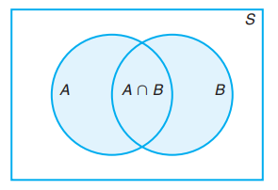
Venn diagrams

Slide 7
Counting Sample Points

Slide 8
Multiplication Rule
If an operation can be performed in n1 ways, and if for each of these ways a second operation can be performed in n2 ways, then the two operations can be performed together in n1n2 ways.

Slide 9
Example
How many sample points are there in the sample space when a pair of dice is thrown once?
Solution:
The first die can land face-up in any one of n1 = 6 ways. For each of these 6 ways, the second die can also land face-up in n2 = 6 ways.
Therefore, the pair of dice can land in
n1n2 = (6)(6) = 36 possible ways.

Slide 10
Example
If a 22-member club needs to elect a chair and a treasurer, how many different ways can these two to be elected?
Solution:
For the chair position, there are 22 total possibilities. For each of those 22 possibilities, there are 21 possibilities to elect the treasurer.
n1 × n2 = 22 × 21 = 462 different ways.

Slide 11
Generalized Multiplication Rule
If an operation can be performed in n1 ways, and if for each of these a second operation can be performed in n2 ways, and for each of the first two a third operation can be performed in n3 ways, and so forth, then the sequence of k operations can be performed in
n1n2 ··· nk ways.

Slide 12
Example
Sam is going to assemble a computer by himself. He has the choice of chips from two brands, a hard drive from four, memory from three, and an accessory bundle from five local stores. How many different ways can Sam order the parts?
Solution:
Since n1 = 2, n2 = 4, n3 = 3, and n4 = 5,
there are nl × n2 × n3 × n4 = 2 × 4 × 3 × 5 = 120

Slide 13
Generalized Multiplication Rule …
Example: How many different license plates can be made if each plate contains a sequence of three uppercase English letters followed by three digits?
Solution: There are 26 choices for each of the three uppercase English letters and ten choices for each of the three digits.
Hence, by the product rule there are a total of 26 · 26 · 26 · 10 · 10 · 10 =17,576,000 possible license plates.

Slide 14

Permutation
A permutation is an arrangement of all or part of a set of objects
The number of permutations of n distinct objects taken r at a time is
Example: Consider the three letters a, b, and c taken two at a time.
The possible permutations are
ab, ac, bc,
ba, ca, cb

Slide 15

Example
In how many different ways can five friends sit for a photograph of five chairs in a row?
$P_{5}^{5}$ = $\frac{5!}{\left(5−5\right)!}$120

Slide 16

Example
A president and a treasurer are to be chosen from a student club consisting of 6 people. How many different choices of officers are possible
$P_{2}^{6}$ = $\frac{6!}{\left(6−2\right)!}$=30

Slide 17

Combinations
In many problems, we are interested in the number of ways of selecting r objects from n without regard to order. These selections are called combinations.
The number of combinations of n distinct objects taken r at a time is

Slide 18

Example
Selecting 4 books from a list of 7 books for a research paper
$C_{4}^{8}$ =$\frac{7!}{4!\left(7−4\right)!}$ =70

Slide 19

Example
How many hockey teams from 6 players can be formed from 14 players
$C_{6}^{14}$ =$\frac{14!}{6!\left(14−6\right)!}$ =3003

Slide 20
Example
Example: A group of 30 people have been trained as astronauts to go on the first mission to Mars. How many ways are there to select a crew of six people to go on this mission (assuming that all crew members have the same job)?
Solution:
^{n}C_{r} = ³⁰C₆ ₌ 30! / 6!(30-6)! =593775

Slide 21

Probability of an Event
https://encrypted-tbn3.gstatic.com/images?q=tbn:ANd9GcTp7bckurNbkPYTpTLAHkLd6RDDxvtknWg_TfcknSM4UerJgMvWsQ

Slide 22
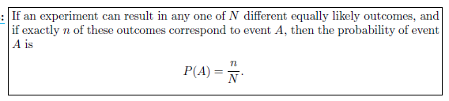
The ratio of number of elements in A to number of elements in S.

Slide 23
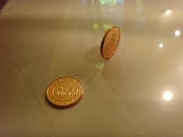
Example: A coin is tossed twice. What is the probability that at least 1 head occurs?
Solution: The sample space for this experiment is
S = {HH,HT, TH, TT}
=4
A = {HH,HT, TH}
=3
P(A) =3/4
https://encrypted-tbn3.gstatic.com/images?q=tbn:ANd9GcRNwtA9liRP8kHwwRIUrYGJxMA_kUk97YJYq6tulHbVuDJbpTT6TA

Slide 24

Example: A die is loaded in such a way that an even number is twice as likely to occur as an odd number. If E is the event that a number less than 4 occurs on a single toss of the die, find P(E).
Solution: The sample space for this experiment is
S = {1, 2, 2, 3, 4, 4, 5, 6, 6, }
= 9
E = {1, 2, 2, 3}
=4
P(E) =4/9
http://www.mises.org.br/Article.aspx?id=1304

Slide 25
Example
Example: A statistics class for engineers consists of 25 industrial, 10 mechanical, 10 electrical, and 8 civil engineering students. If a person is randomly selected by the instructor to answer a question, find the probability that the student chosen is an industrial engineering major
Solution:
S = The total number of students in the class = ⁵³C₁
A = an industrial engineering major = ²⁵C₁
P(A) =²⁵C₁/⁵³C₁

Slide 26
Example
A statistics class for engineers consists of 25 industrial, 10 mechanical, 10 electrical, and 8 civil engineering students. If a person is randomly selected by the instructor to answer a question, find the probability that the student chosen is (a) an industrial engineering major and (b) a civil engineering or an electrical engineering major.
Solution
P(industrial engineering major ) = ²⁵C₁/⁵³C₁ ₌ 25/ 53
P(a civil engineering or an electrical engineering major) = ¹⁸C₁/⁵³C₁ ₌ 18/ 53

Slide 27
Example
Example: In a poker hand consisting of 5 cards, find the probability of holding 2 aces and 3 Jacks.
Solution: The sample space for this experiment is
S = The total number of 5-card poker hands, all of which are equally .
= ⁵²C₅ =2,598,960.
A = 2 aces and 3 Jacks
= ⁴C₂ ⁴C₃ =6*4 = 24
P(A) = 24/2,598,960 = 0.9* 10⁻⁵

Slide 28
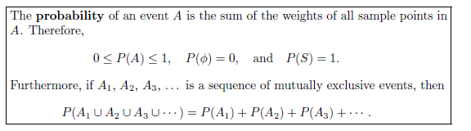
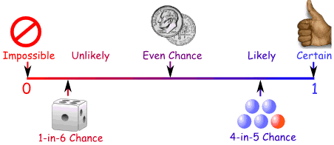
https://www.mathsisfun.com/data/probability.html

Slide 29
Additive Rules

Slide 30
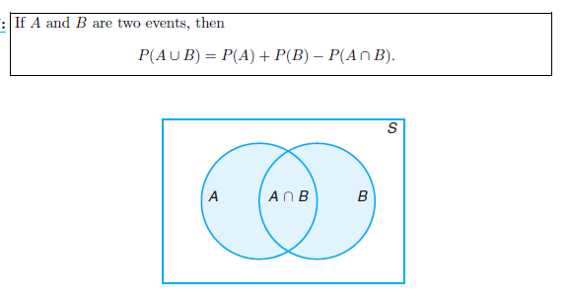
Addition Law for Not Mutually Exclusive Events

Slide 31
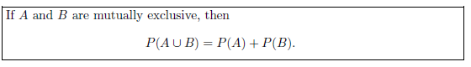
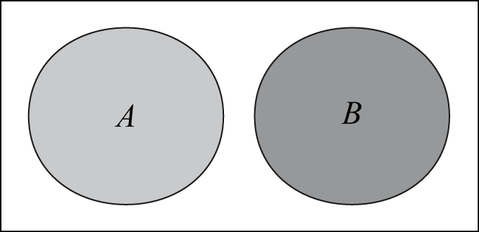
Addition Law for Mutually Exclusive Events
if A and B are mutually exclusive, A∩B = 0 and then P(A∩B) = P(φ) = 0.

Slide 32
Example : John is going to graduate from an industrial engineering department in a university by the end of the semester. After being interviewed at two companies he likes, he assesses that his probability of getting an offer from company A is 0.8, and his probability of getting an offer from company B is 0.6. If he believes that the probability that he will get offers from both companies is 0.5, what is the probability that he will get at least one offer from these two companies?
Solution :
P(A ∪ B) = P(A) + P(B) − P(A ∩ B) = 0.8 + 0.6 − 0.5 = 0.9.

Slide 33
Example : What is the probability of getting a total of 7 or 11 when a pair of fair dice is tossed?
Solution :
S = 36
A = Getting a total of 7
= 6
P(A) =6/36
B = Getting a total of 11
= 2
P(A) = 2/36
P(A ∩ B) = 0
P(A ∪ B) = P(A) + P(B) − P(A ∩ B)
= 6/36 + 2/36 − 0 = 8/36

Slide 34


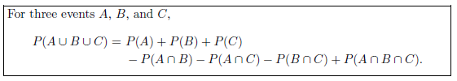

Slide 35
Example : If the probabilities are, respectively, 0.09, 0.15, 0.21, and 0.23 that a person purchasing a new automobile will choose the color green, white, red, or blue, what is the probability that a given buyer will purchase a new automobile that comes in one of those colors?
Solution :
P(G ∪W ∪ R ∪ B) = P(G) + P(W) + P(R) + P(B)
= 0.09 + 0.15 + 0.21 + 0.23
= 0.68.

Slide 36

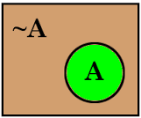
Complementary Events

Slide 37
Example :If the probabilities that an automobile mechanic will service 3, 4, 5, 6, 7, or 8 or more cars on any given workday are, respectively, 0.12, 0.19, 0.28, 0.24, 0.10, and 0.07, what is the probability that he will service at least 5 cars on his next day at work?
Solution :
Let E be the event that at least 5 cars are serviced.
Now, P(E')= 1 − P(E),
where E is the event that fewer than 5 cars are serviced.
Since P(E) = 0.12 + 0.19 = 0.31,
it follows that
P(E') = 1 − 0.31 = 0.69.

Slide 38
Assignment Page No 59
2.49
2.52
2.53
2.54
2.56
2.58
2.60
2.61
2.63
2.64
2.66
2.67

